Slide 1
Hisilicon Inkless Format Requirements V1.3

Slide 2
Change Description
In order to unify the Inkless format of various homes, Hisilicon made this change with the following adjustments:
Inkless Summary : file content format
Inkless Map : content format
each lot is transmitted using compressed files
Page3-8 Inkless format requirements for CP mass production packaging, Inkless provided by CP Vendor
Page9-11 is after the strict screening of CP abnormal batches, click on the Die file format requirements, the file is provided by HISI, this is discussed together in this change, because the RS Die, CP Vendor also need to read in, and then Merge Die by RS Ink to CPC Map

Slide 3
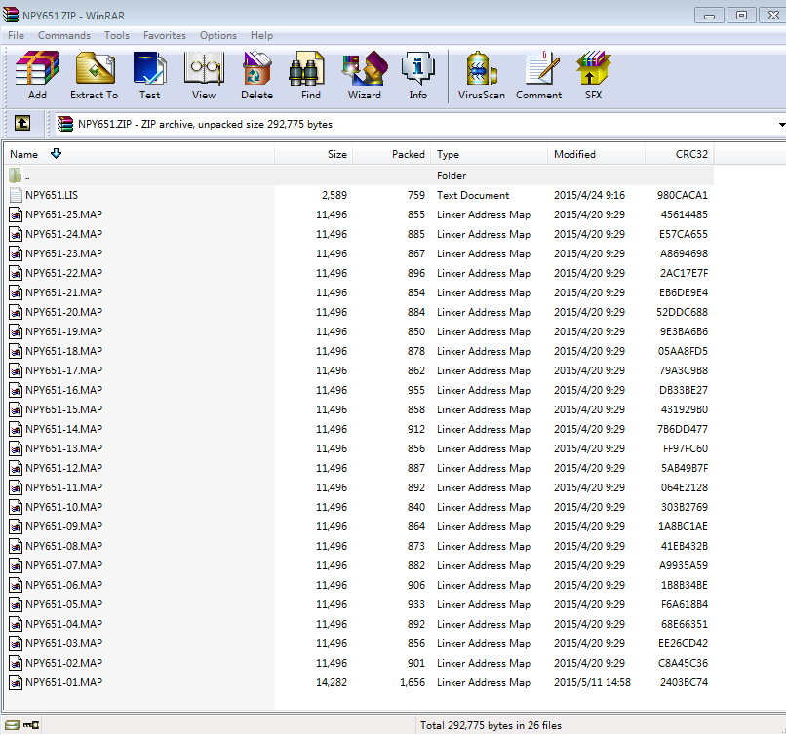
1. INKLESS : Convention de dénomination des fichiers
Refer to the right picture:
1. In Lot, each Inkless file is compressed using ZIP, and the file name is LOT ID.zip. The Lot ID is the same as the HISI CP test work order. If there is lot disassembly (refer to point 5 or self-definition for lot disassembly rules), the Lot ID can be suffixed. The lot IDs below 2, 3, and 4 are the same as this rule.
Example: NPY651.zip Example (unpacking): NPY651L1.zip
2. The compressed file contains the INKLESS Map file and list file for each wafer.
3. List file naming rules:LOT ID.LIS。 Example： NPY651.LIS
4. Map file naming convention： LOT ID-wafer No.MAP 。 Example NPY651-01.MAP ou NPY651-AI774TD（IBM wafer）
5. Split lot rules: Customer lot number + L + Wafer ID code of the first piece. ZIP
For example, in this batch of 25 pieces, this shipment is 1 ~ 10,14. The batch number is E5N744L1.ZIP.
For example, this batch of 25 pieces; this shipment of 10-25 batches E5N744LA.ZIP
If you don’t open the batch, you must use the guest batch + LWaferID.zip
If there is no dismantling, you must use the guest batch + LWaferID.LIS

Slide 4
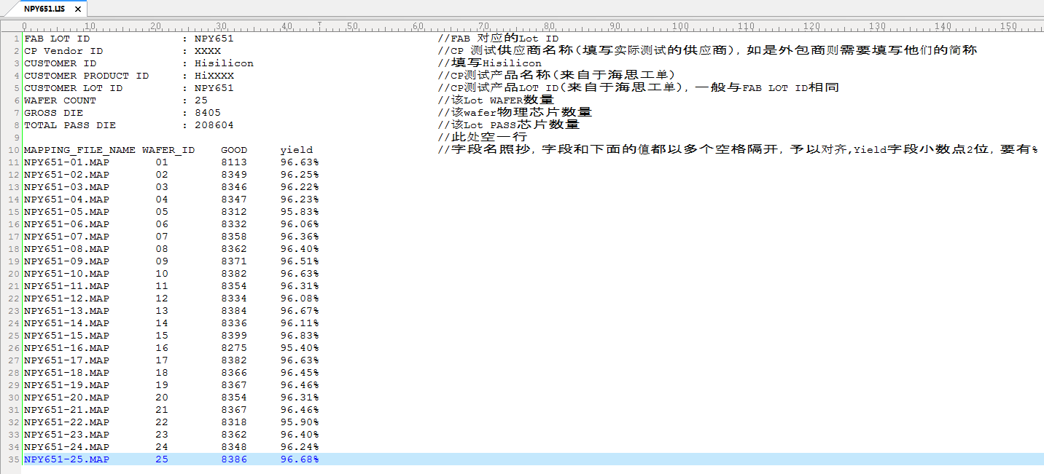
2. INKLESS list file format specification
Good->BIN1
Add Partial Good Bin
1
A B 。。。
Refer to the left picture:
The list file 1-8 is the header. The header information is the same as the CPC Map. Please see the note at the back of the //. TOTAL PASS DIE is the number of Lot Pass IC
Line 10 is the field name. Copy it, separated by at least one space, all uppercase.
Field description:
MAPPING_FILE_NAME: Inkless file name for each wafer of this Lot
WAFER_ID: Consistent with CPC Map, cannot contain Lot ID
GOOD: Number of Good Dies that can be packaged
YIELD: corresponding yield of wafer

Slide 5
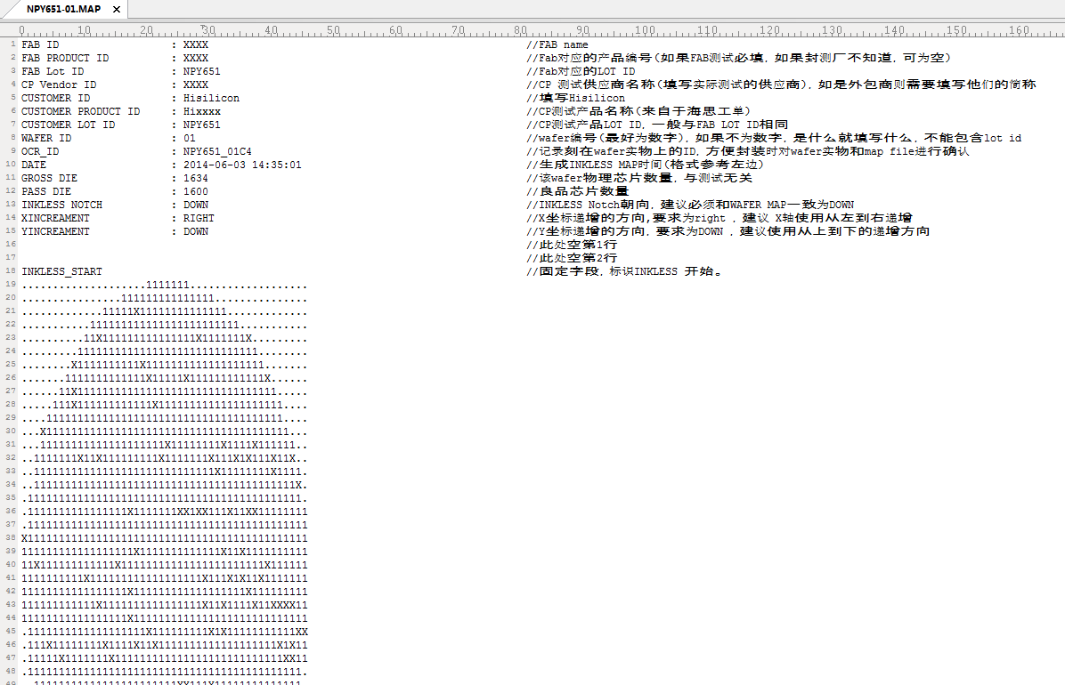
3. INKLESS MAP file format specification
Refer to the left picture:
Line 1-15 is the header. The header information is the same as CPC Map. Please see the comment at the back.
Line 18 is the MAP start identifier
The beginning of line 19 is the content of the Inkless map. The Inkless Map states:
"1" means PASS DIE, to be encapsulated
“A,B,C,D。。。”, Partial Good Bin
“X”表示FAIL DIE，Not encapsulated
“.” Indicates blank

Slide 6
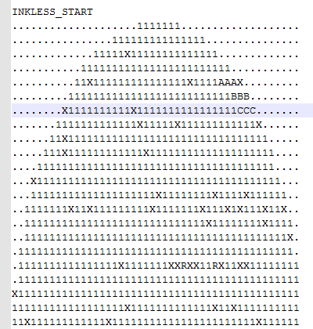
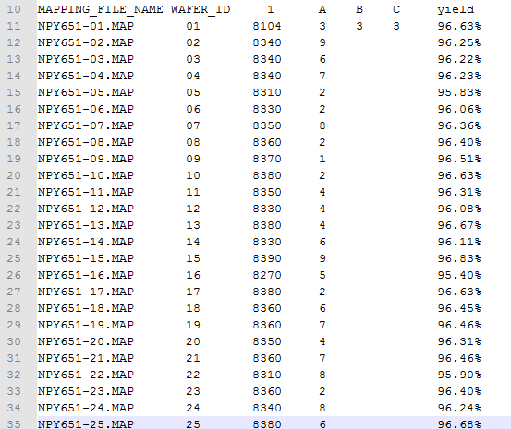
INKLESS File:Current New
Inkless Map explanation：
Current：
a.“1”表示PASS DIE，To encapsulate
b.“X”表示FAIL DIE，Not encapsulated
c.“.” Indicates blank
New Request：（Bin definition according to CP Release Form）Release form will update accordingly
a.“1”Express PASS DIE，To encapsulate
b.“A,B,C,D。。。”, Partial Good Bin To encapsulate
c.“X” express FAIL DIE，Not encapsulated
d.“.” Indicates blank
LIST File:Current New

Slide 7
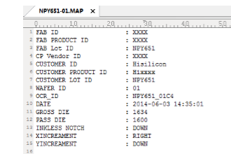
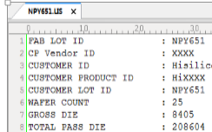
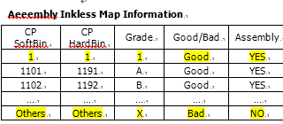
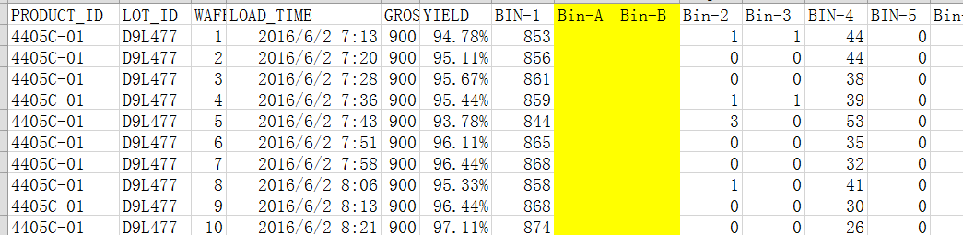
INKLESS File
LIST File
The number of PASS DIE in the Inkless file and List File is the sum of the number of “Good” Bin (Grade) defined in the CP release form “Good / bad”, as shown in the figure on the right is 1 + A + B
Ship Yield Report
Shipping Yield Report:
Need to add the corresponding number of DG Good Bad Bins, Yield calculates the sum of Good Bins

Slide 8
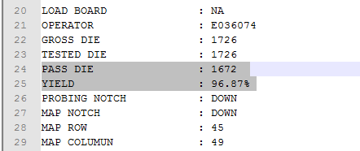
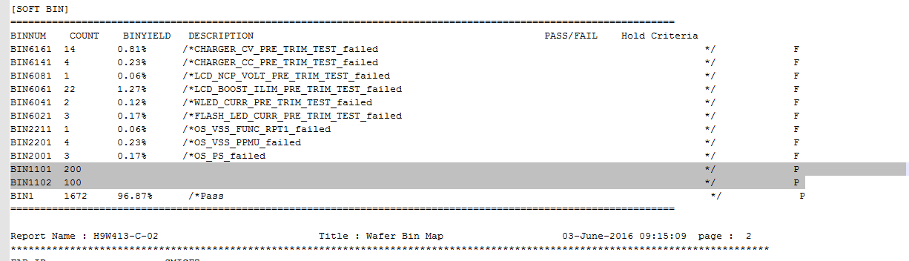
CP Map
The PASS DIE and Yield calculation in the CP / CPC Map file is calculated as the sum of the number of “Good” Bin (Grade) defined in the CP release form “Good / bad” (as shown on the right)
DG Bin needs to be displayed on the Soft Bin (see below)

Slide 9
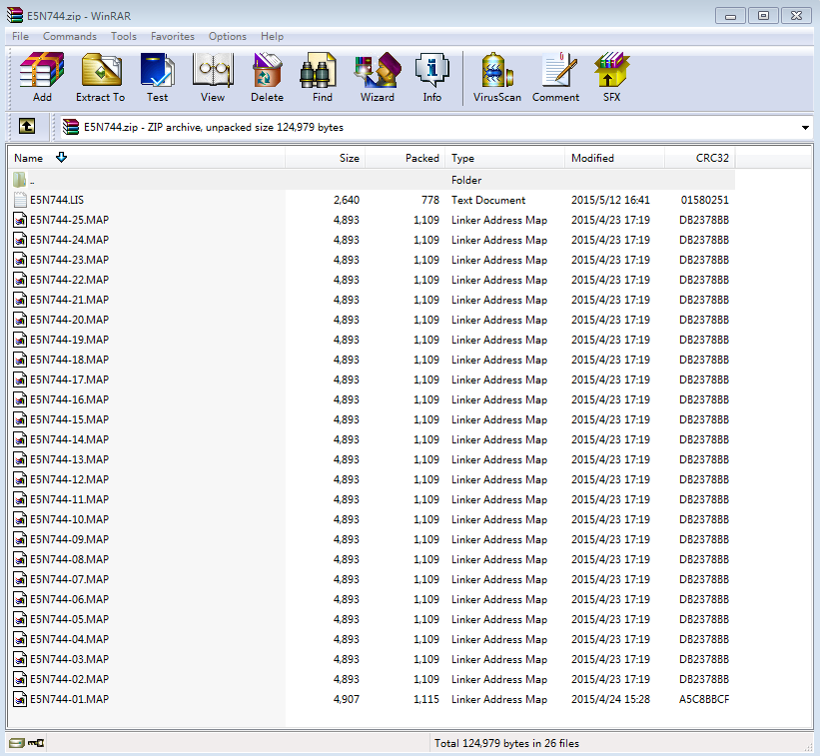
2.1 Map file naming convention returned to CP Vendor after HISI RS
Refer to the right picture:
In Lot, the map file after HISI RS is compressed using ZIP. Example: E5N744.zip
The compressed file contains the post-RS Map file and list file of the affected wafer.
List file naming convention: LOT ID.LIS. Example: E5N744.LIS
Map file naming convention: LOT ID-wafer No.MAP. Example: E5N744-01.MAP or 5N744-AI774TD (IBM wafer)
If you don’t open the batch, you must use the guest batch + LWaferID.zip
If you don’t open the batch, you also need to use the guest batch + LWaferID.LIS
It is recommended not to use LOT ID, use Wafer ID.MAP directly
LOT ID: E5N744.00
TSMC Wafer ID: E5N744-01F5
File Name: E5N744-01.MAP
IBM Wafer ID: AI774TD
File Name: AI774TD.MAP

Slide 10
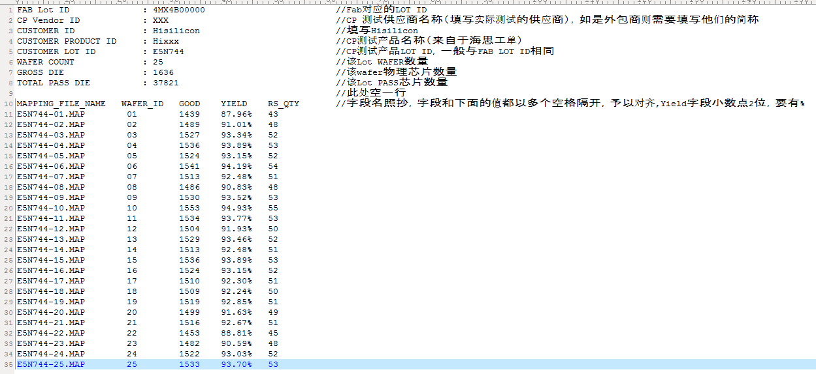
2.2 HISI List file format specification returned to CP Vendor after RS
Refer to the left picture:
The list file 1-8 is the header. The header information is the same as the CPC Map. Please see the comment at the back of it, where TOTAL PASS DIE is the number of Lot PASS ICs.
Line 10 is the field name. Copy it, separated by at least one space, all uppercase.
Field description:
MAPPING_FILE_NAME: RS Map file name for each wafer of this Lot
WAFER_ID: Consistent with CPC Map, cannot contain Lot ID
GOOD: Number of Good Dies that can be packaged
YIELD: corresponding yield of wafer
RS_QTY: RS screening quantity

Slide 11
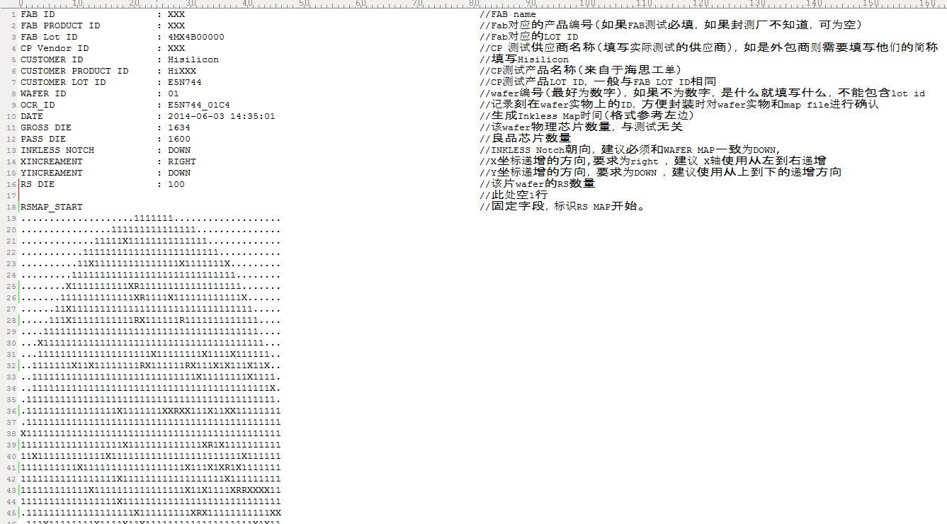
2.3 HISI Map file format specification returned to CP Vendor after RS
Refer to the left picture:
The list file 1-15 is the header. The header information is the same as CPC Map.
Line 18 is the MAP start identifier
The beginning of line 19 is the content of the Inkless map. The Inkless Map states:
"1" means PASS DIE,
"X" means FAIL DIE,
"." Means blank,
"R" means RS FAIL DIE

